Slide 1
DTS205TC High Performance Computing
Lecture 1 Infrastructure 1
Di Zhang, Spring 2024

Slide 2
Technology stack
Applications(Database, ML, Big Data, etc.)
Serial algorithm
Parallel algorithm
4
5
Teaching Sequence
Supporting Libraries
3
Infrastructure
Machine
Network
Machine
2
1
Machine
For hardware, parallel algorithms should try to make full use of it to improve performance
For applications, regardless of whether the algorithm is serial or parallel, it should ensure that their calculation steps are equivalent, or output consistent or approximate result
Supporting Libraries: Abstract the hardware and communication process to facilitate the development process

Slide 3
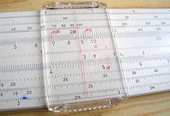
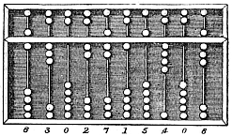
What is a Computer?
Suanpan
Slidable Ruler
Three-Body
Minecraft
Notes:
https://en.wikipedia.org/wiki/Computer

Slide 4
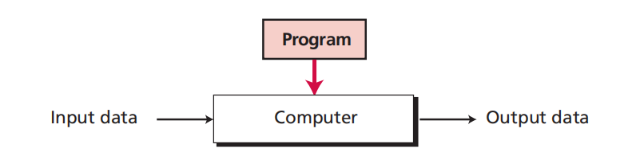
What is a Computer?
A single-purpose computing machine
programmable data processor

Slide 5
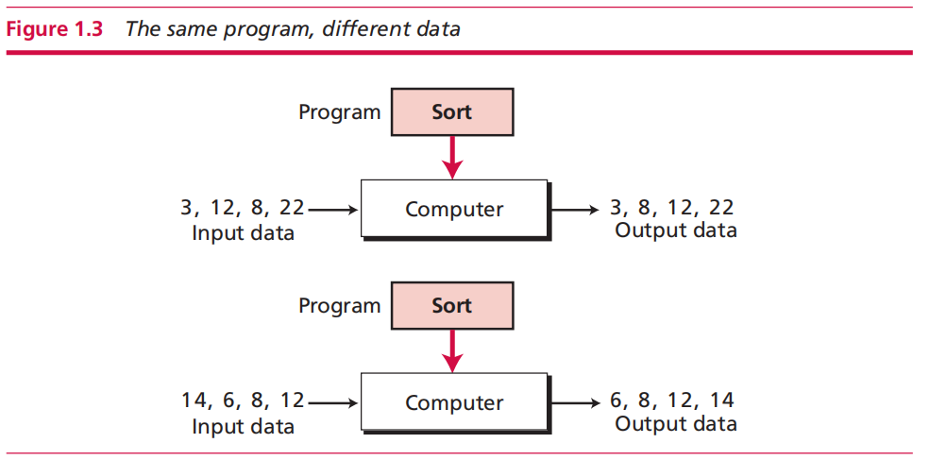
Cases

Slide 6
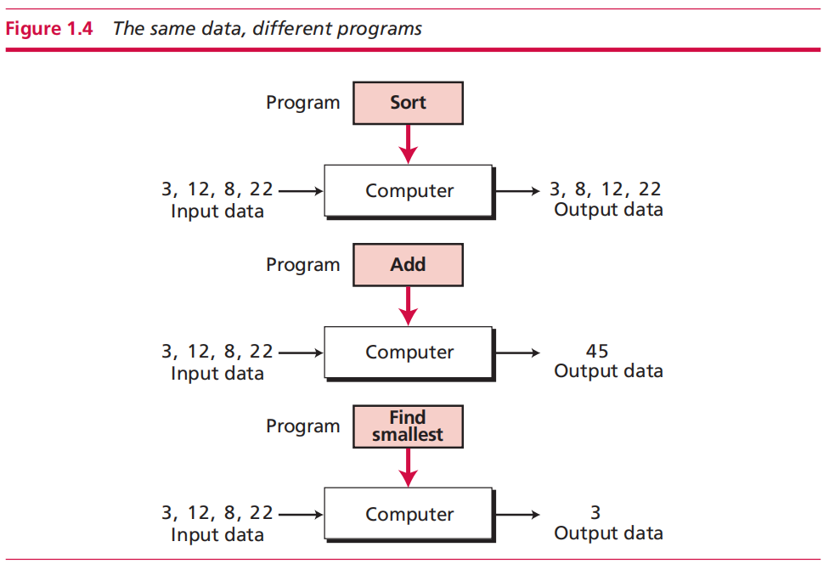
Cases

Slide 7
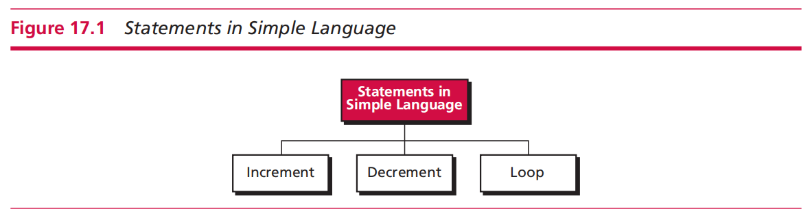
How to build a conceptual computer?
Simple Language + Machine on Paper

Slide 8
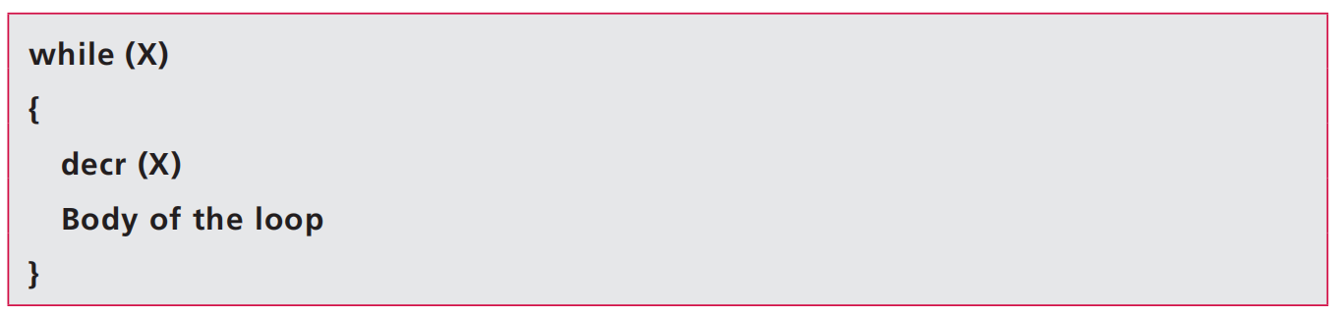
Simple Language

Slide 9
Examples
As powerful as any sophisticated language, e.g. C, Python, etc.
  X ← 0
  X ← n
  Y ← X
  Y ← Y + X
  Y ← Y × X
  if X then A

Slide 10
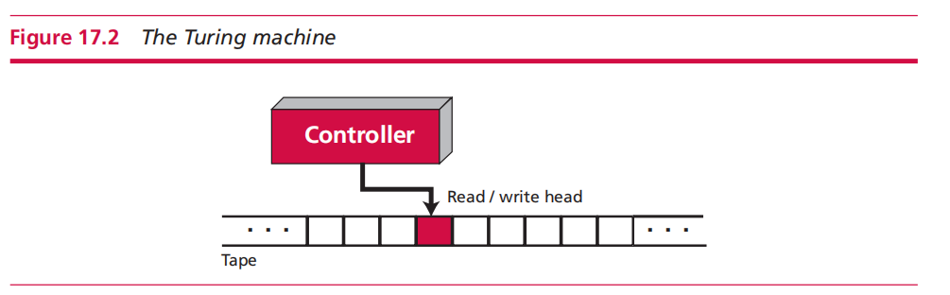

Turing Machine
  Tape
  Read/write head
  Controller

Slide 11
Demo
https://doodles.google/doodle/alan-turings-100th-birthday/

Slide 12
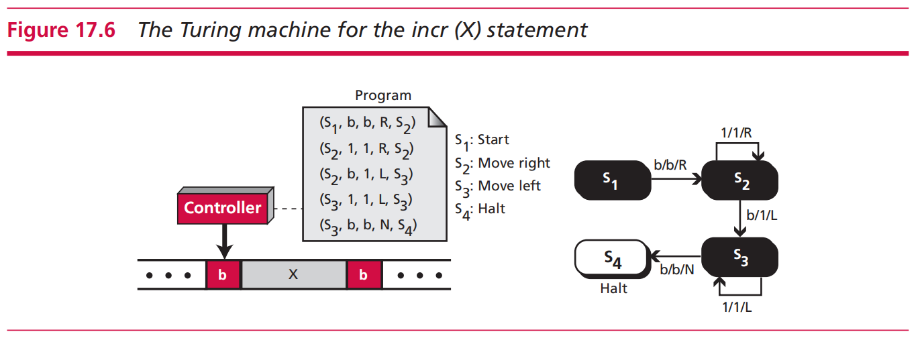

Slide 13
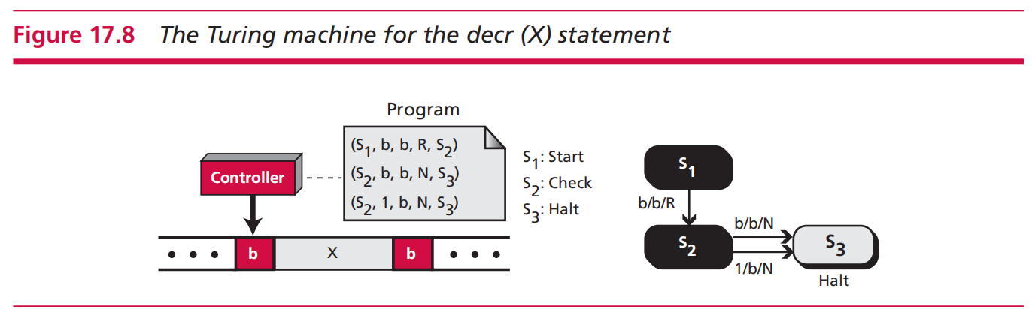

Slide 14
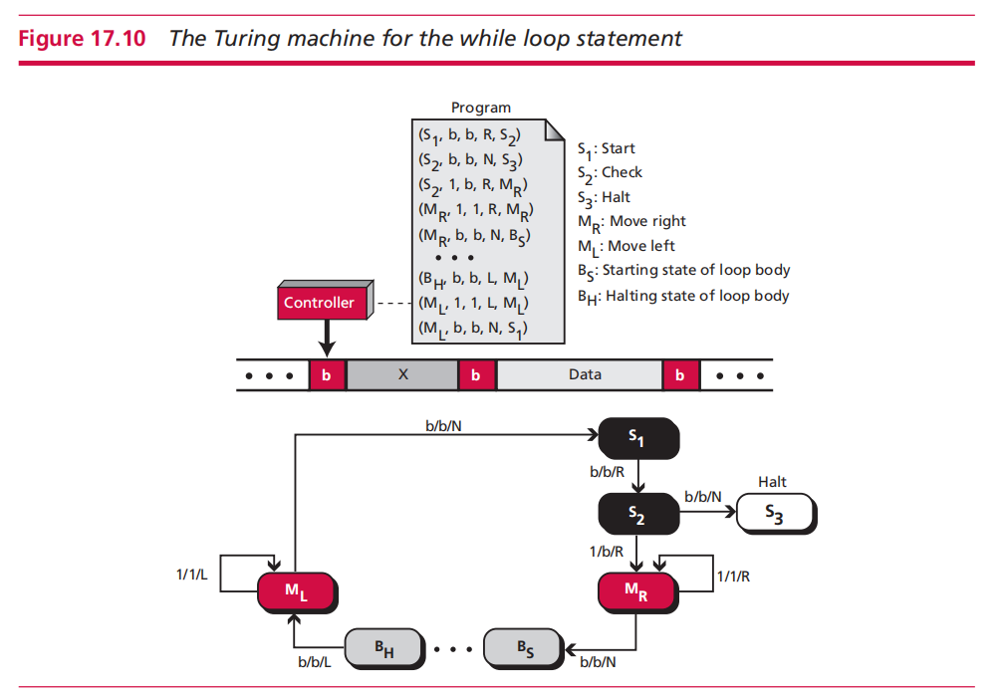

Slide 15
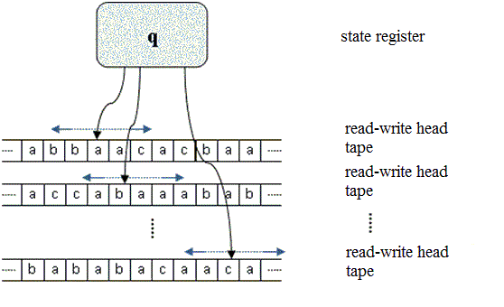
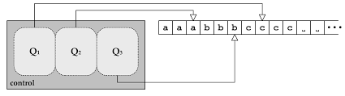
*Turing Machine and Parallel Computing
Computationally equivalent to serial version

